Slide 1
Software Process Models
Agile development Approaches

Slide 2
Outline
Agile methods
Plan-driven and agile development
Extreme programming (XP)
Scrum
Scaling up agile methods

Slide 3
Rapid software development
Rapid development and delivery is now often the most important requirement for software systems
  Businesses operate in a fast–changing environment
  Software has to evolve quickly to reflect changing business needs
Rapid software development characteristics:
  Specification, design and implementation are inter-leaved
  System is developed as a series of versions with stakeholders involved in version evaluation
  User interfaces are often developed using an IDE and graphical toolset

Slide 4
Agile Methods
Dissatisfaction with the overheads involved in software design methods of the 1980s and 1990s led to the creation of agile methods. These methods:
  Focus on the code rather than the design
  Are based on an iterative approach to software development
  Are intended to deliver working software quickly and evolve this quickly to meet changing requirements
The aim of agile methods is to reduce overheads in the software process (e.g. by limiting documentation) and to be able to respond quickly to changing requirements without excessive rework

Slide 5
Agile manifesto
“We are uncovering better ways of developing software by doing it and helping others do it. Through this work we have come to value:
  Individuals and interactions over processes and tools;
  Working software over comprehensive documentation;
  Customer collaboration over contract negotiation;
  Responding to change over following a plan;
That is, while there is value in the items on the right, we value the items on the left more.”

Slide 6
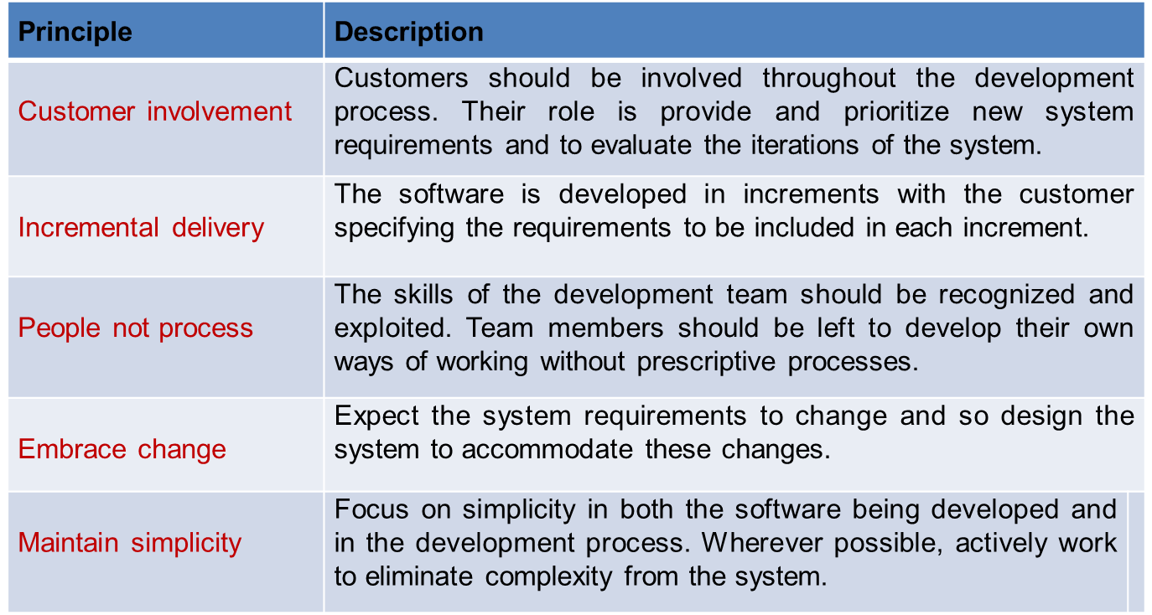
The principles of agile methods

Slide 7
Agile method applicability
Product development where a software company is developing a small or medium-sized product for sale
Custom system development within an organization, where there is a clear commitment from the customer to become involved in the development process and where there are not a lot of external rules and regulations that affect the software
Because of their focus on small, tightly-integrated teams, there are problems in scaling agile methods to large systems

Slide 8
Problems with agile methods
It can be difficult to keep the interest of customers who are involved in the process
Team members may be unsuited to the intense involvement that characterizes agile methods
Prioritizing changes can be difficult where there are multiple stakeholders
Maintaining simplicity requires extra work
Contracts may be a problem as with other approaches to iterative development

Slide 9
Agile methods and software maintenance
Most organizations spend more on maintaining existing software than they do on new software development. So, if agile methods are to be successful, they have to support maintenance as well as original development
Two key issues:
  Are systems that are developed using an agile approach maintainable, given the emphasis in the development process of minimizing formal documentation?
  Can agile methods be used effectively for evolving a system in response to customer change requests?
Problems may arise if original development team cannot be maintained

Slide 10
Plan-driven and agile development
Plan-driven development
  A plan-driven approach to software engineering is based around separate development stages with the outputs to be produced at each of these stages planned in advance
  Not necessarily waterfall model – plan-driven, incremental development, spiral (Boehm) are also possible
  Iteration occurs within activities
Agile development
  Specification, design, implementation and testing are inter-leaved and the outputs from the development process are decided through a process of negotiation during the software development process

Slide 11
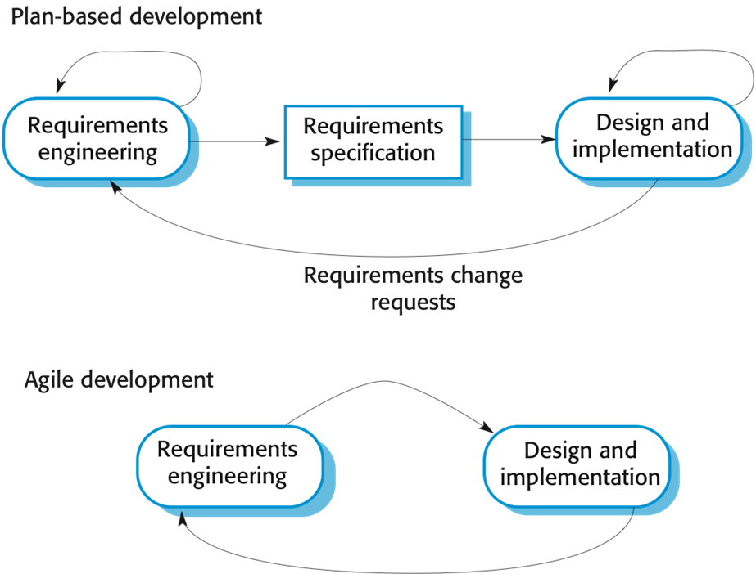
Plan-driven and agile specification

Slide 12
Technical, human, organizational issues
Most projects include elements of plan-driven and agile processes. Deciding on the balance depends on:
  Is it important to have a very detailed specification and design before moving to implementation? If so, you probably need to use a plan-driven approach
  Is an incremental delivery strategy, where you deliver the software to customers and get rapid feedback from them, realistic? If so, consider using agile methods.
  How large is the system that is being developed? Agile methods are most effective when the system can be developed with a small co-located team who can communicate informally. This may not be possible for large systems that require larger development teams so a plan-driven approach may have to be used.

Slide 13
Technical, human, organizational issues
  What type of system is being developed?
    Plan-driven approaches may be required for systems that require a lot of analysis before implementation (e.g. real-time system with complex timing requirements)
  What is the expected system lifetime?
    Long-lifetime systems may require more design documentation to communicate the original intentions of the system developers to the support team
  What technologies are available to support system development?
    Agile methods rely on good tools to keep track of an evolving design
  How is the development team organized?
    If the development team is distributed or if part of the development is being outsourced, then you may need to develop design documents to communicate across the development teams

Slide 14
Technical, human, organizational issues
  Are there cultural or organizational issues that may affect the system development?
    Traditional engineering organizations have a culture of plan-based development, as this is the norm in engineering
  How good are the designers and programmers in the development team?
    It is sometimes argued that agile methods require higher skill levels than plan-based approaches in which programmers simply translate a detailed design into code
  Is the system subject to external regulation?
    If a system has to be approved by an external regulator (e.g. the FAA approve software that is critical to the operation of an aircraft) then you will probably be required to produce detailed documentation as part of the system safety case

Slide 15
Extreme programming
Perhaps the best-known and most widely used agile method.
Extreme Programming (XP) takes an “extreme” approach to iterative development
  New versions may be built several times per day;
  Increments are delivered to customers every 2 weeks;
  All tests must be run for every build and the build is only accepted if tests run successfully

Slide 16
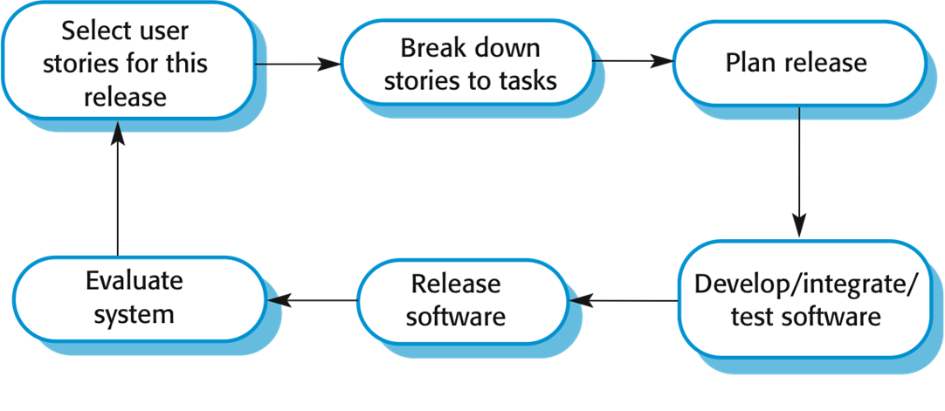
The XP cycle

Slide 17
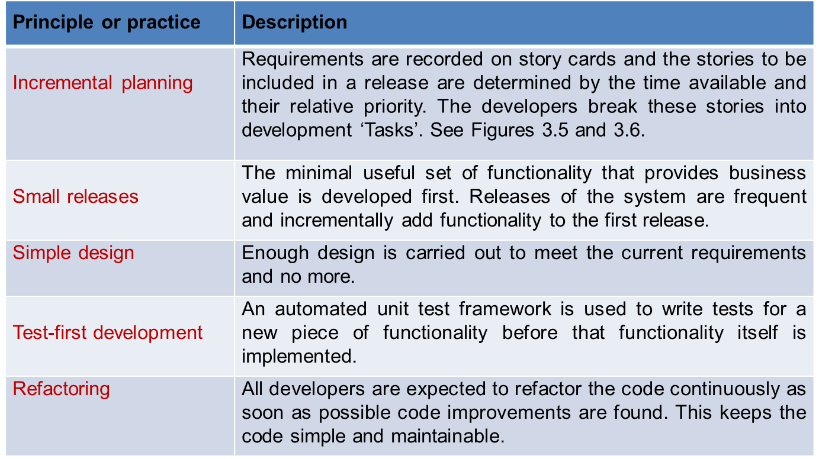
Extreme programming practices (a)

Slide 18
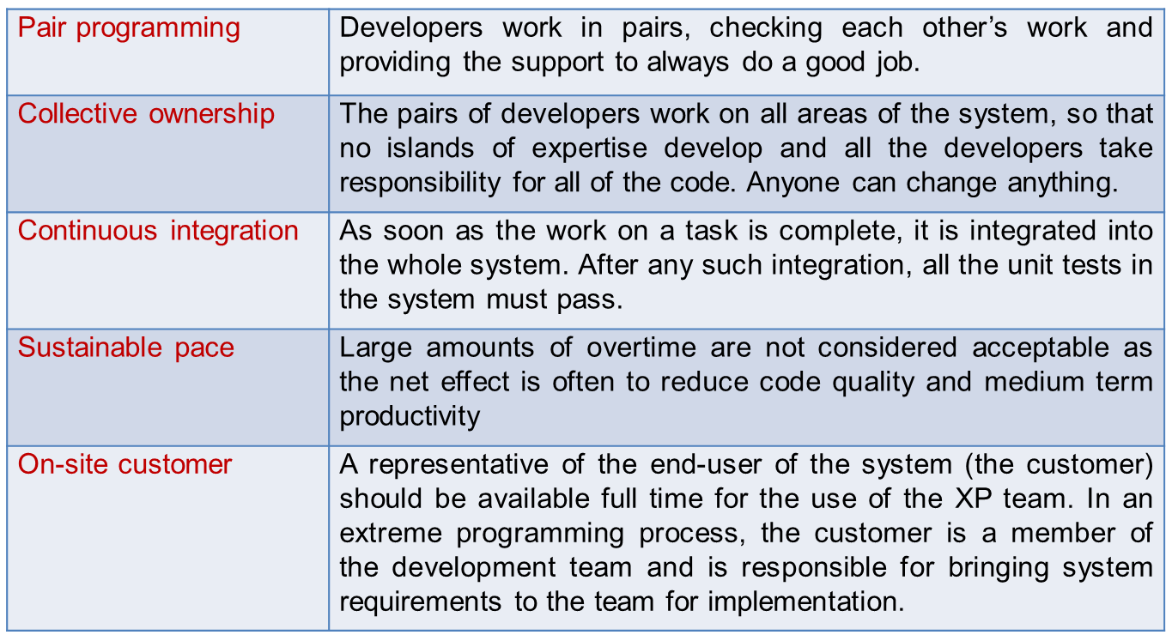
Extreme programming practices (b

Slide 19
XP and agile principles
Incremental development is supported through small, frequent system releases
Customer involvement means full-time customer engagement with the team
People not process through pair programming, collective ownership and a process that avoids long working hours.
Change supported through regular system releases
Maintaining simplicity through constant refactoring of code

Slide 20
Requirements scenarios
In XP, a customer or user is part of the XP team and is responsible for making decisions on requirements.
User requirements are expressed as scenarios or user stories.
These are written on cards and the development team break them down into implementation tasks. These tasks are the basis of schedule and cost estimates.
The customer chooses the stories for inclusion in the next release based on their priorities and the schedule estimates.

Slide 21
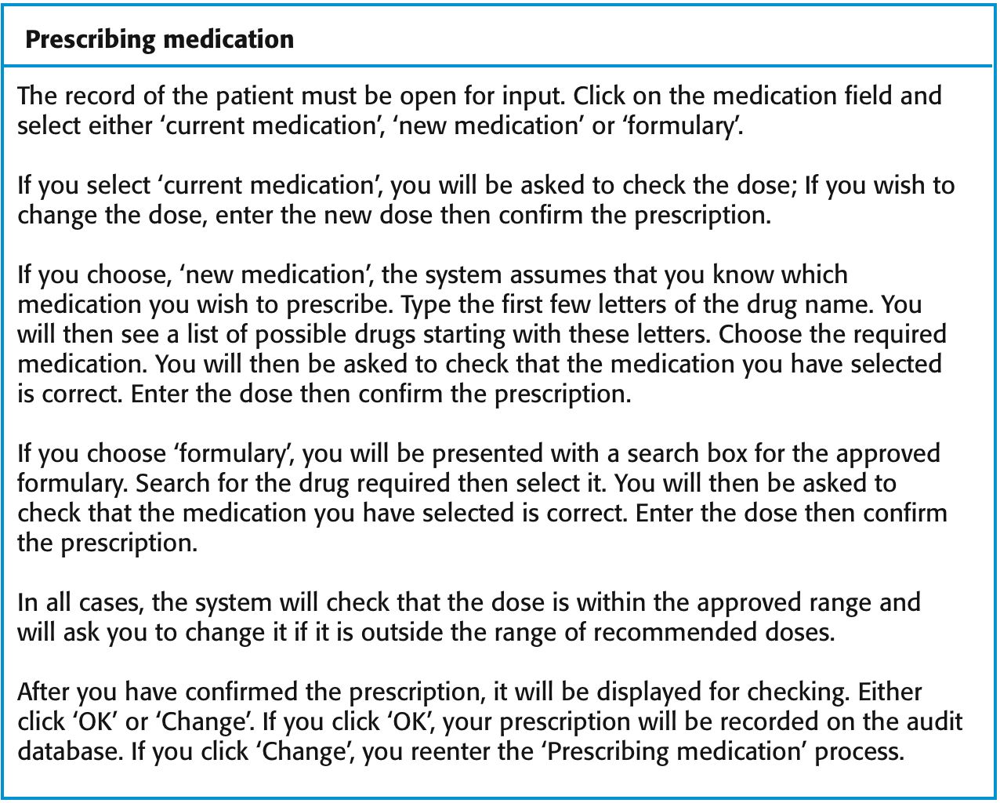
A ‘prescribing medication’ story: case study

Slide 22
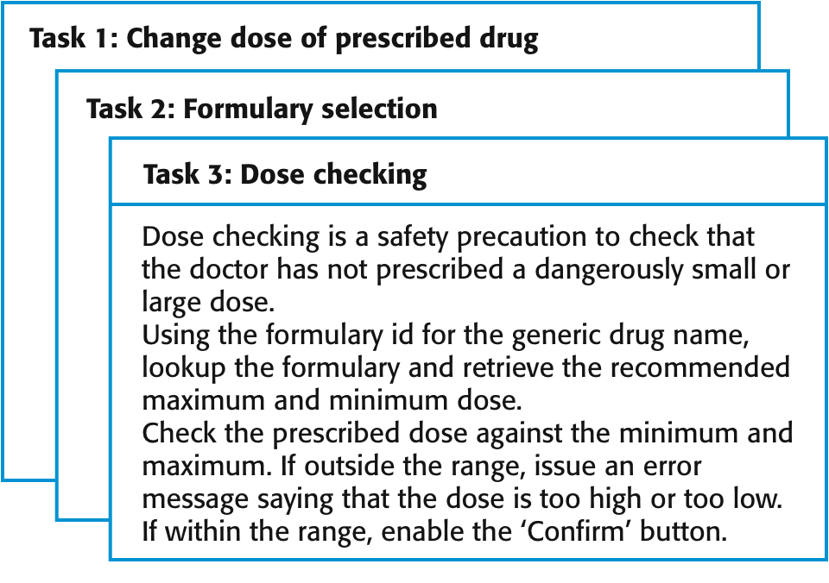
Examples of task cards for prescribing medication

Slide 23
XP and change
Conventional wisdom in software engineering is to design for change. It is worth spending time and effort anticipating changes as this reduces costs later in the life cycle.
XP, however, maintains that this is not worthwhile as changes cannot be reliably anticipated
Rather, it proposes constant code improvement (refactoring) to make changes easier when they have to be implemented

Slide 24
Refactoring
Programming team look for possible software improvements and make these improvements even where there is no immediate need for them
This improves the understandability of the software and so reduces the need for documentation
Changes are easier to make because the code is well-structured and clear
However, some changes requires architecture refactoring and this is much more expensive.

Slide 25
Examples of refactoring
Re-organization of a class hierarchy to remove duplicate code
Tidying up and renaming attributes and methods to make them easier to understand
The replacement of inline code with calls to methods that have been included in a program library

Slide 26
Testing in XP
Testing is central to XP and XP has developed an approach where the program is tested after every change has been made.
XP testing features:
  Test-first development
  Incremental test development from scenarios
  User involvement in test development and validation
  Automated test harnesses are used to run all component tests each time that a new release is built

Slide 27
Test-first development in XP
Writing tests before code clarifies the requirements to be implemented.
Tests are written as programs rather than data so that they can be executed automatically. The test includes a check that it has executed correctly.
  Usually relies on a testing framework such as Junit.
All previous and new tests are run automatically when new functionality is added, thus checking that the new functionality has not introduced errors

Slide 28
Customer involvement
The role of the customer in the testing process is to help develop acceptance tests for the stories that are to be implemented in the next release of the system.
The customer who is part of the team writes tests as development proceeds. All new code is therefore validated to ensure that it is what the customer needs.
However, people adopting the customer role have limited time available and so cannot work full-time with the development team. They may feel that providing the requirements was enough of a contribution and so may be reluctant to get involved in the testing process.

Slide 29
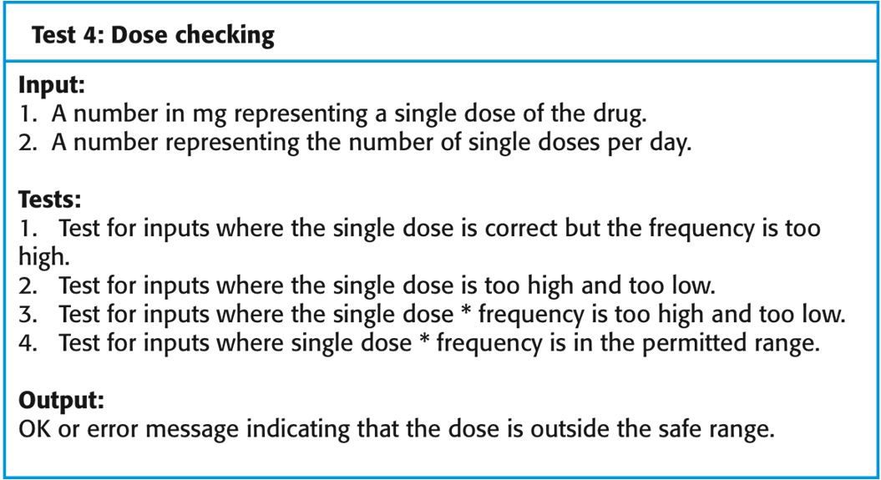
Test case description for dose checking

Slide 30
XP testing difficulties
Programmers prefer programming to testing and sometimes they take short cuts when writing tests. For example, they may write incomplete tests that do not check for all possible exceptions that may occur.
Some tests can be difficult to write incrementally. For example, in a complex user interface, it is often difficult to write unit tests for the code that implements the ‘display logic’ and workflow between screens.
It difficult to judge the completeness of a set of tests. Although you may have a lot of system tests, your test set may not provide complete coverage.

Slide 31
Pair programming
In XP, programmers work in pairs, sitting together to develop code.
This helps develop common ownership of code and spreads knowledge across the team.
It serves as an informal review process as each line of code is looked at by more than 1 person.
It encourages refactoring as the whole team can benefit from this.
Measurements suggest that development productivity with pair programming is similar to that of two people working independently.

Slide 32
Advantages of pair programming
It supports the idea of collective ownership and responsibility for the system
  Individuals are not held responsible for problems with the code. Instead, the team has collective responsibility for resolving these problems.
It acts as an informal review process because each line of code is looked at by at least two people
It helps support refactoring, which is a process of software improvement
  Where pair programming and collective ownership are used, others benefit immediately from the refactoring so they are likely to support the process

Slide 33
Scrum
The Scrum approach is a general agile method but its focus is on managing iterative development rather than specific agile practices
There are three phases in Scrum:
  The initial phase is an outline planning phase where you establish the general objectives for the project and design the software architecture
  This is followed by a series of sprint cycles, where each cycle develops an increment of the system
  The project closure phase wraps up the project, completes required documentation such as system help frames and user manuals and assesses the lessons learned from the project

Slide 34
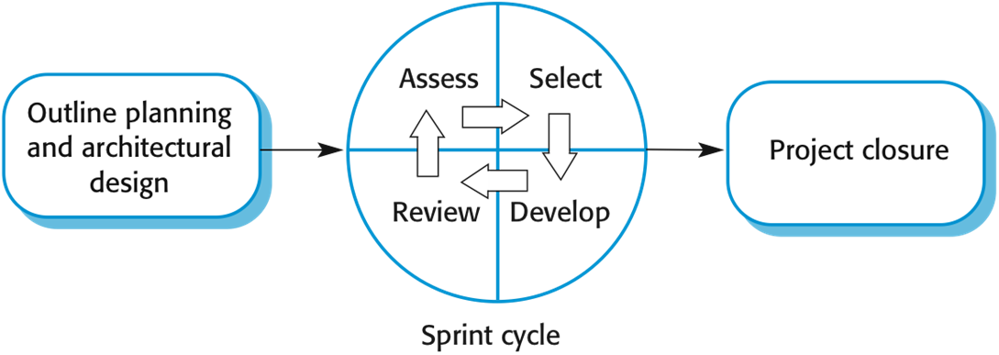
The Scrum process

Slide 35
The Sprint cycle
Once these are agreed, the team organize themselves to develop the software. During this stage the team is isolated from the customer and the organization, with all communications channelled through the so-called Scrum master
The role of the Scrum master is to protect the development team from external distractions
At the end of the sprint, the work done is reviewed and presented to stakeholders. The next sprint cycle then begins.

Slide 36
Teamwork in Scrum
The ‘Scrum master’ is a facilitator who arranges daily meetings, tracks the backlog of work to be done, records decisions, measures progress against the backlog and communicates with customers and management outside of the team.
The whole team attends short daily meetings where all team members share information, describe their progress since the last meeting, problems that have arisen and what is planned for the following day.
  This means that everyone on the team knows what is going on and, if problems arise, can re-plan short-term work to cope with them.

Slide 37
Scrum benefits
The product is broken down into a set of manageable and understandable chunks
Unstable requirements do not hold up progress
The whole team have visibility of everything and consequently team communication is improved
Customers see on-time delivery of increments and gain feedback on how the product works
Trust between customers and developers is established and a positive culture is created in which everyone expects the project to succeed

Slide 38
Scaling agile methods
Agile methods have proved to be successful for small and medium sized projects that can be developed by a small co-located team
It is sometimes argued that the success of these methods comes because of improved communications which is possible when everyone is working together
Scaling up agile methods involves changing these to cope with larger, longer projects where there are multiple development teams, perhaps working in different locations.

Slide 39
Large systems development
Large systems are usually collections of separate, communicating systems, where separate teams develop each system. Frequently, these teams are working in different places, sometimes in different time zones.
Large systems are ‘brownfield systems’, that is they include and interact with a number of existing systems. Many of the system requirements are concerned with this interaction and so don’t really lend themselves to flexibility and incremental development.
Where several systems are integrated to create a system, a significant fraction of the development is concerned with system configuration rather than original code development

Slide 40
Large system development
Large systems and their development processes are often constrained by external rules and regulations limiting the way that they can be developed.
Large systems have a long procurement and development time. It is difficult to maintain coherent teams who know about the system over that period as, inevitably, people move on to other jobs and projects.
Large systems usually have a diverse set of stakeholders. It is practically impossible to involve all of these different stakeholders in the development process.

Slide 41
Scaling out and scaling up
‘Scaling up’ is concerned with using agile methods for developing large software systems that cannot be developed by a small team
‘Scaling out’ is concerned with how agile methods can be introduced across a large organization with many years of software development experience
When scaling agile methods it is essential to maintain agile fundamentals
  Flexible planning, frequent system releases, continuous integration, test-driven development and good team communications.

Slide 42
Scaling up to large systems
For large systems development, it is not possible to focus only on the code of the system. You need to do more up-front design and system documentation.
Cross-team communication mechanisms have to be designed and used. This should involve regular phone and video conferences between team members and frequent, short electronic meetings where teams update each other on progress.
Continuous integration, where the whole system is built every time any developer checks in a change, is practically impossible. However, it is essential to maintain frequent system builds and regular releases of the system.

Slide 43
Scaling out to large companies
Project managers who do not have experience of agile methods may be reluctant to accept the risk of a new approach.
Large organizations often have quality procedures and standards that all projects are expected to follow and, because of their bureaucratic nature, these are likely to be incompatible with agile methods.
Agile methods seem to work best when team members have a relatively high skill level. However, within large organizations, there are likely to be a wide range of skills and abilities.
There may be cultural resistance to agile methods, especially in those organizations that have a long history of using conventional systems engineering processes.

Slide 44
Summary
Agile methods are incremental development methods that focus on rapid development, frequent releases of the software, reducing process overheads and producing high-quality code. They involve the customer directly in the development process.
The decision on whether to use an agile or a plan-driven approach to development should depend on the type of software being developed, the capabilities of the development team, and the culture of the company developing the system.
Extreme programming is a well-known agile method that integrates a range of good programming practices such as frequent releases of the software, continuous software improvement and customer participation in the development team.

Slide 45
Summary
A particular strength of extreme programming is the development of automated tests before a program feature is created. All tests must successfully execute when an increment is integrated into a system.
The Scrum method is an agile method that provides a project management framework. It is centred round a set of sprints, which are fixed time periods when a system increment is developed.
Scaling agile methods for large systems is difficult. Large systems need up-front design and a lot of documentation.

